Slide 1
Annotations in Java
Annotations are used to provide supplemental information about a program.
Annotations start with ‘@’.
Annotations do not change the action of a compiled program.
Annotations help to associate metadata (information) to the program elements i.e. instance variables, constructors, methods, classes, etc

Slide 2
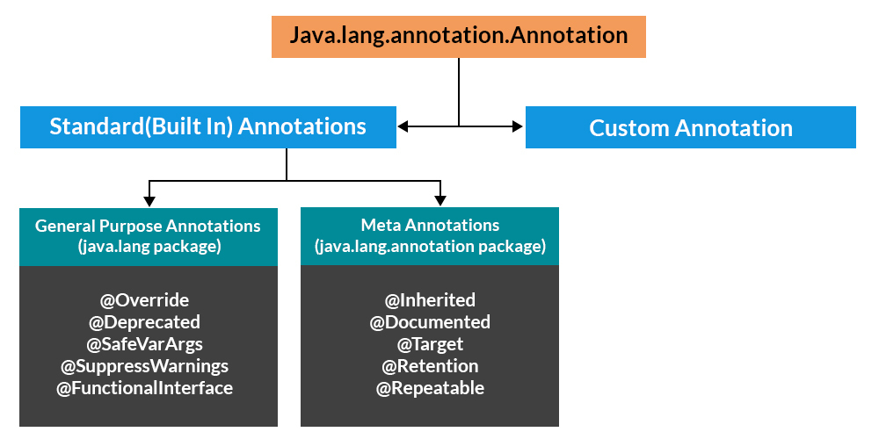

Slide 3
Categories of Annotations
There are broadly 5 categories of annotations as listed:
Marker Annotations
Single value Annotations
Full Annotations
Type Annotations
Repeating Annotations

Slide 4
Marker Annotations
These annotations contain no members and do not consist of any data.
@Override is an example of Marker Annotation.
Example
@TestAnnotation()
Single value Annotations
These annotations contain only one member and allow a shorthand form of specifying the value of the member. In order to use this shorthand, the name of the member must be a value.
Example
@TestAnnotation(“testing”);
Full Annotations
These annotations consist of multiple data members, names, values, pairs.
Example
@TestAnnotation(owner=”Rahul”, value=”Class Geeks”)

Slide 5
Type Annotations
These annotations can be applied to any place where a type is being used. For example, we can annotate the return type of a method. These are declared annotated with @Target annotation.
Repeating Annotations
These applied to a single item more than once. For an annotation to be repeatable it must be annotated with the @Repeatable annotation, which is defined in the java.lang.annotation package.
The container is specified as an annotation whose value field is an array of the repeatable annotation type.

Slide 6
Built-In Java Annotations used in Java code
@Override
@SuppressWarnings
@Deprecated
@Target
@Retention
@Inherited
@Documented
@Target
Built-In Java Annotations used in other annotations

Slide 7
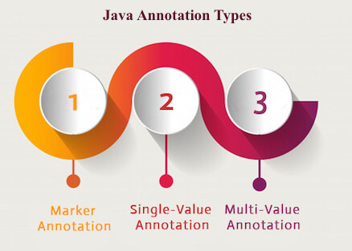

Slide 8
1) Marker Annotation
An annotation that has no method, is called marker annotation. For example:
@interface MyAnnotation{}
The @Override and @Deprecated are marker annotations.
2) Single-Value Annotation
An annotation that has one method, is called single-value annotation. For example:
@interface MyAnnotation{
int value();
}
3) Multi-Value Annotation
An annotation that has more than one method, is called Multi-Value annotation. For example:
@interface MyAnnotation{
int value1();
String value2();
String value3();
}
}

Slide 9
THE END

